Slide 1

Special Topics in Biometrics, CS599
Final Project : Detection of emotions from speech
Praneeth Narisetty
Boston University MET College
Prof. Zoran B. Djordjević

Slide 2
Table of Contents
Introduction
Why Speech Emotion Detection?
Tools & Datasets
Code & Libraries
Data Visualisation and Exploration
1. Count of Emotions
2. Mel Spectrogram & MFCC
Data Augmentation
Data & Feature
CNN Model
Training and Validation
Final Validation
Conclusion
References
Praneeth Narisetty

Slide 3
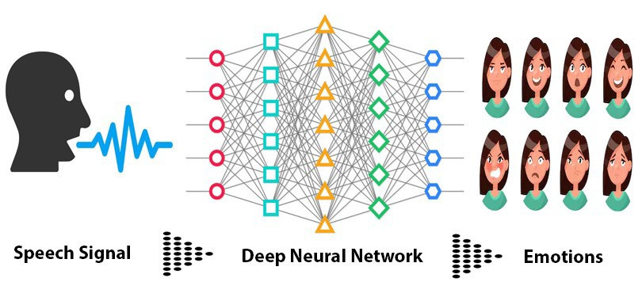
Introduction
In the rapidly advancing field of biometric technology the ability to accurately detect and analyze human emotions through speech stands out as a pivotal innovation. Biometrics the science of identifying and analyzing human characteristics has traditionally focused on physical traits such as fingerprints, iris patterns and facial recognition. However, the scope of biometrics extends beyond these physical markers to include behavioral traits among which vocal characteristics are profoundly indicative of a person’s emotional state.
This project aims to harness the power of machine learning algorithms and audio processing libraries to develop a robust model that can discern and categorize emotional states from speech data. By doing so, it contributes to the broader field of affective computing and opens new pathways for human-computer interaction.
3
Praneeth Narisetty

Slide 4
Why Speech Emotion Detection?
Healthcare Applications: In a medical or therapeutic setting, speech emotion detection can offer insights into a patient's psychological state, aiding in the diagnosis and monitoring of mental health conditions. This application can provide continuous non-invasive analysis that supports therapeutic goals.
Forensic and Legal Use: In legal contexts, speech emotion detection can provide insights into a speaker’s psychological state during testimonies or interrogations, offering additional layers of context for law enforcement and judicial review.
User Experience and Interaction: In systems that interact with humans, such as customer service kiosks or personal assistants, recognizing and responding to emotional states can greatly enhance user experience. This adaptability can lead to more natural and efficient interactions, increasing user satisfaction and system usability.
Enhancing Security: Integrating emotion detection with speech in biometric systems can help identify emotional stress or anomalies in behavior that might indicate security threats or fraudulent activities, providing a more sophisticated security analysis.
4
Praneeth Narisetty

Slide 5


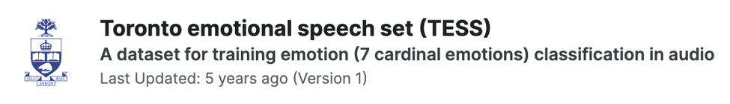
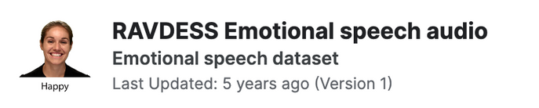
Tools & Datasets
A cloud-based Python programming environment that offers free access to computing resources including GPUs. It is widely used for machine learning projects due to its ease of use and ability to share notebooks directly.
The Crowd-Sourced Emotional Multimodal Actors Dataset (CREMA-D) consists of 7,442 clips from 91 actors, portraying a range of emotions through facial expressions, body movements, and vocal expressions. This diverse dataset is crucial for training models to recognize emotional subtleties in speech.
This dataset features voice recordings from two actresses encompassing seven different emotions, expressed in a variety of sentences. The consistent recording setting and clear labeling of emotions make TESS an excellent resource for training and testing speech emotion recognition algorithms.
The Ryerson Audio-Visual Database of Emotional Speech and Song (RAVDESS) includes audio recordings of 24 professional actors, male and female, performing scripts in both neutral and strong emotional tones. The dataset is highly controlled for tone and expression, providing high-quality data for analysis of vocal emotion.
5
Praneeth Narisetty

Slide 6

Code & Libraries
Libraries:
Pandas
os and sys
NumPy
Seaborn
Matplotlib
Librosa
Scikit-learn
TensorFlow
Keras
IPython.display & Audio from IPython.display
Programming Language:
Python
6
Praneeth Narisetty

Slide 7
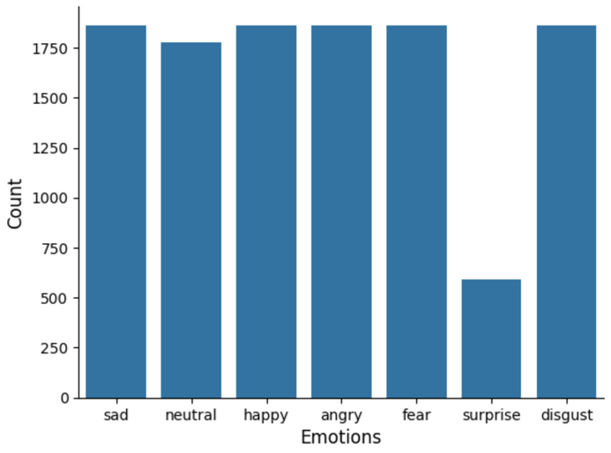
Data Visualisation and Exploration
Count of Emotions:
This visualization helps in understanding the balance or imbalance among different emotional categories in the data, which is crucial for training a well-performing model.
Each bar represents the count of audio samples labeled with emotions such as sadness, neutrality, happiness, anger, fear, surprise, and disgust.
7
Praneeth Narisetty

Slide 8
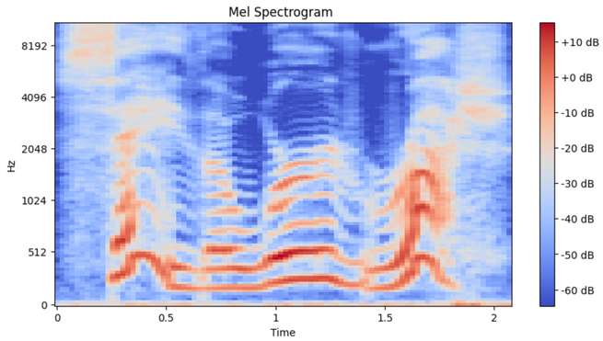
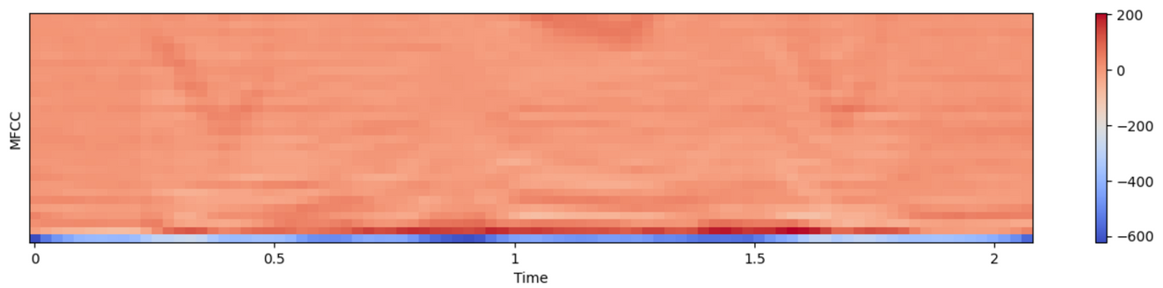
Data Visualisation and Exploration
Mel Spectrogram & MFCC:
Mel Spectrograms are essential for analyzing the frequency content of audio signals and are widely used in speech recognition tasks to capture the textural aspects of sound that are relevant for distinguishing between different emotions.
MFCCs are crucial for speech and audio processing as they mimic the human ear's behavior and are thus highly effective in voice recognition and speaker identification tasks. They provide a compact representation of the sound based on the perception of pitch and tone, which are fundamental in recognizing emotional nuances in speech.
8
Praneeth Narisetty

Slide 9
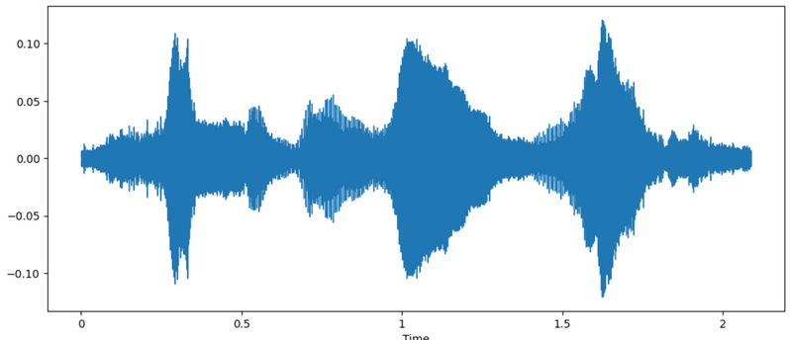
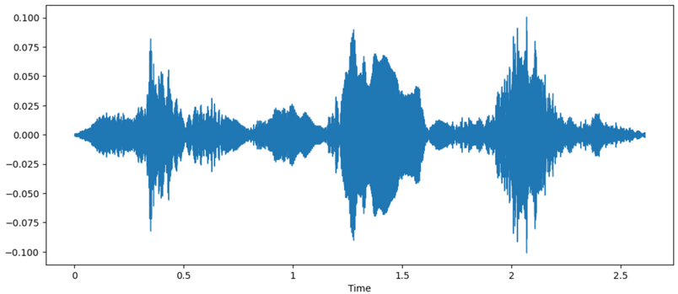
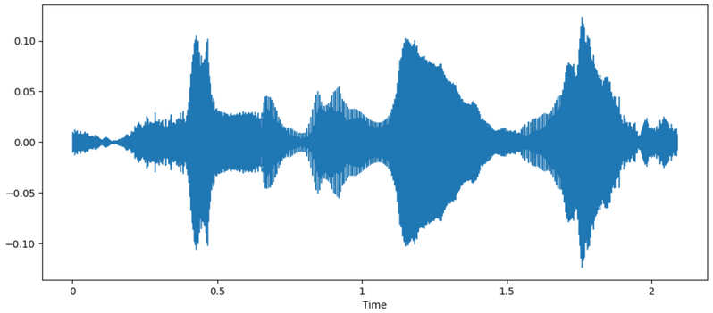
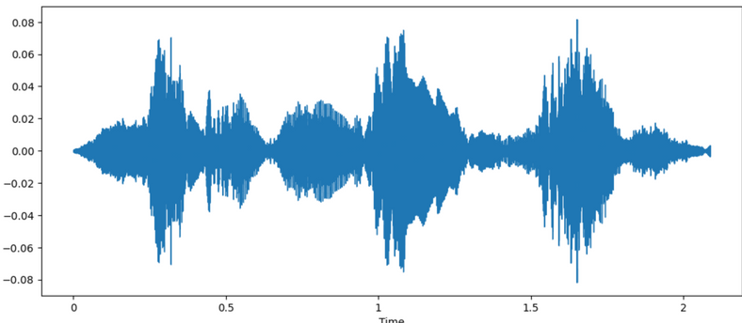
Data Augmentation
Data augmentation is a technique used in machine learning to increase the diversity and quantity of training data by generating modified versions of the existing data. This is particularly useful when acquiring new data is expensive or impractical. Techniques used in the project: Noise, Shifting, Stretching, Pitch.
Noise:
Stretched:
Shifted:
Pitch:
9
Praneeth Narisetty

Slide 10
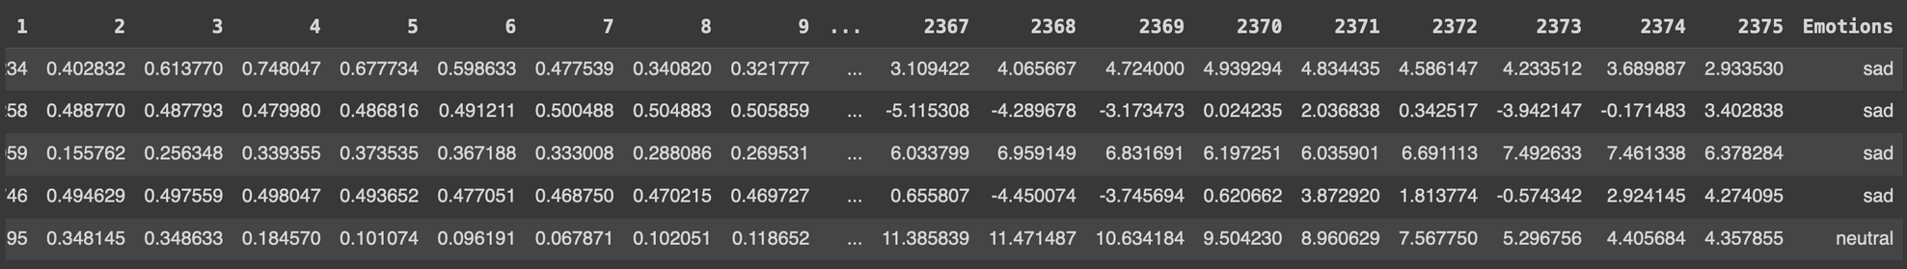
Data & Feature
The feature extraction functions are designed to process audio data and extract significant audio features such as Mel-frequency cepstral coefficients (MFCCs), Zero Crossing Rate, and Root Mean Square (RMS) values.
Output: The fully processed DataFrame is saved as a CSV file for persistence and further use in model training.
From an initial set of 11 features, we selected three primary features for our final dataset
10
Praneeth Narisetty

Slide 11
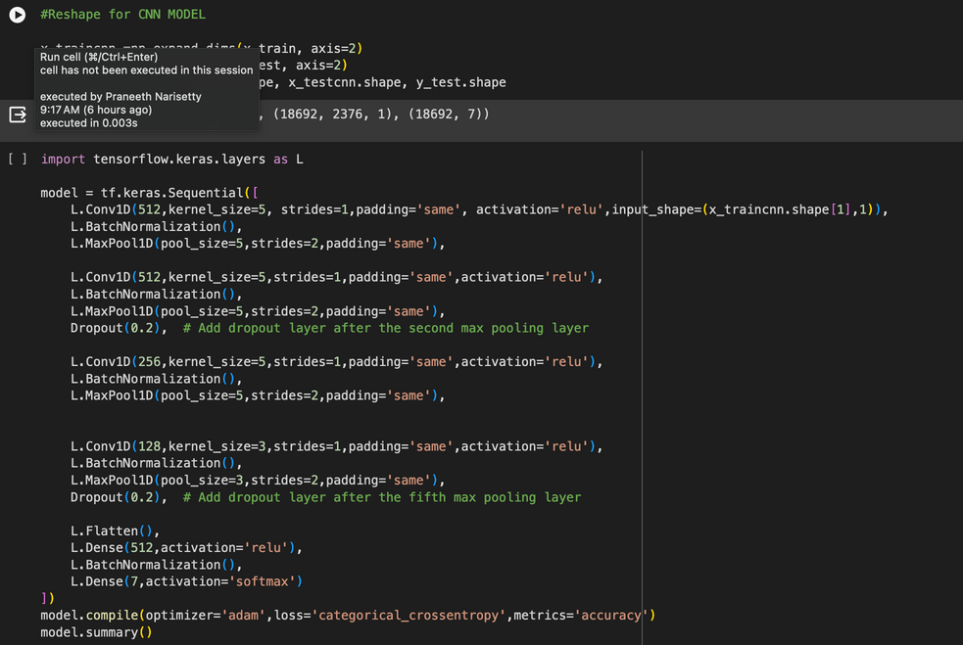
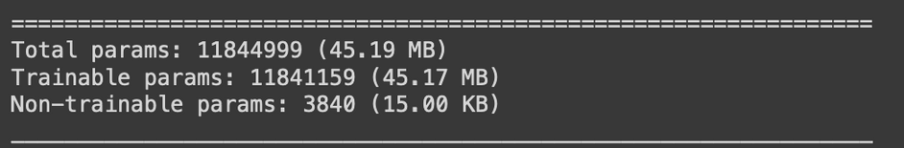
CNN Model
CCN (Convolutional Neural Network) model is built using TensorFlow and Keras, employing a sequential architecture suitable for handling complex patterns in data, such as those found in audio feature sets.
The model is compiled with the Adam optimizer and categorical cross-entropy loss function, which is typical for multi-class classification tasks.
Metrics tracked include accuracy, providing a direct indication of model performance during training and validation.
Output
11
Praneeth Narisetty

Slide 12
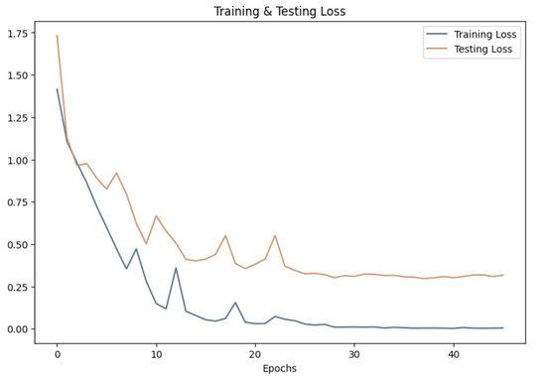
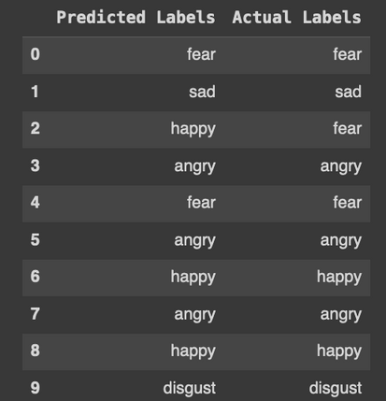
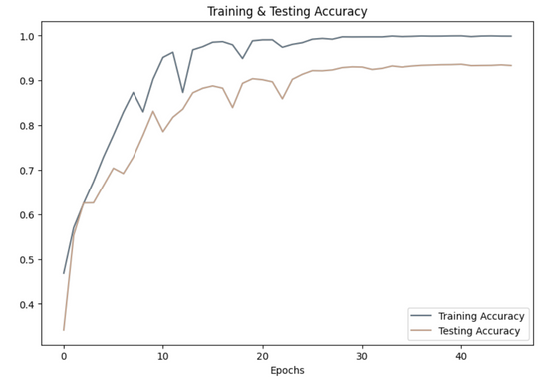
Training and Validation
The model's training and validation phases were carefully monitored to evaluate performance and ensure robust learning without overfitting.
The model was trained over 46 epochs, showing how the performance improved with each iteration.
Accuracy of our model on test data : 93.62 %
12
Praneeth Narisetty

Slide 13
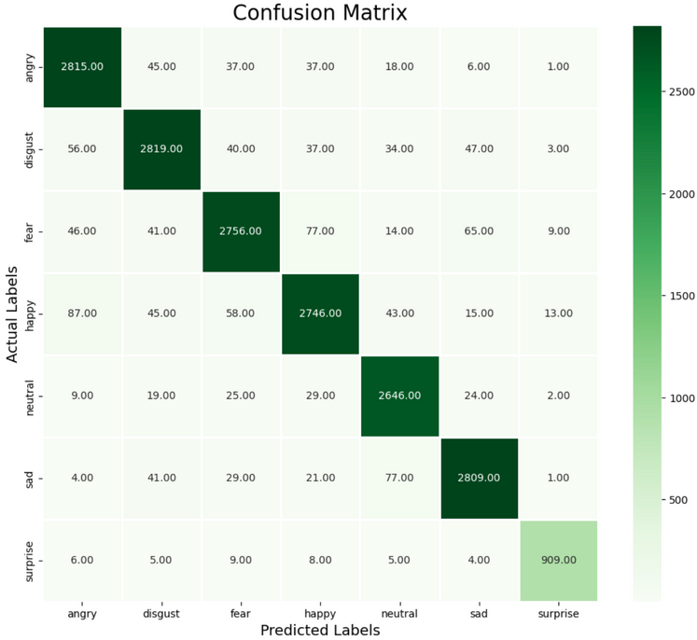
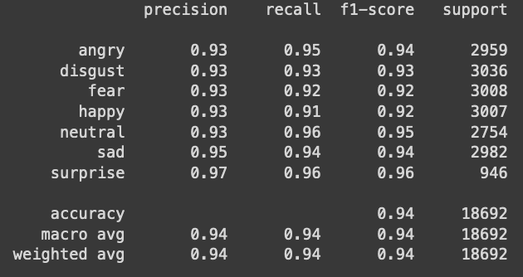
Final Validation
The final evaluation of our model displays a comprehensive classification report and confusion matrix, which are instrumental in understanding the model's performance across different emotional states.
Reflecting a balance between precision and recall, the F1-scores are consistently high across emotions, suggesting effective harmonic mean performance between precision and recall.
The model reached an impressive overall accuracy of 94%
13
Praneeth Narisetty

Slide 14
Conclusion
Project achieved a notable 94% accuracy in speech emotion recognition, with particular strength in identifying surprise, neutral, and angry emotions. This performance underscores the model’s capability in extracting and interpreting key audio features effectively.
Moving forward, to further improve and validate the model’s robustness, Plan to explore additional datasets and experiment with alternative features. This will help enhance the model's adaptability and accuracy across various emotional expressions and real-world scenario.
14
Praneeth Narisetty

Slide 15
References
Elsevier. (2023, August 14). Speech emotion recognition using machine learning - A systematic review. Intelligent Systems with Applications. https://www.sciencedirect.com/science/article/pii/S2667305323000911
Runner, P. (2020, April 10). Audio signal feature extraction and clustering. Medium. https://medium.com/heuristics/audio-signal-feature-extraction-and-clustering-935319d2225
Zhao, Y., & Shu, X. (2023, November 21). Speech emotion analysis using Convolutional Neural Network (CNN) and gamma classifier-based error correcting output codes (ECOC). Nature News. https://www.nature.com/articles/s41598-023-47118-4
Mostafaabdlhamed. (2023, July 1). Speech emotion recognition. Kaggle. https://www.kaggle.com/code/mostafaabdlhamed/speech-emotion-recognition-97-25-accuracy/notebook
15
Praneeth Narisetty

Slide 16
Videos
15 Min Video:
https://youtu.be/XAwQ7SPDXtY
5 Min Video:
https://youtu.be/eg7mo_tlFr4
15
Praneeth Narisetty

Slide 17
Thank You

